Slide 1
Area of Focus Awards 2019 - 2020
Rotary District 6970
18 Outstanding Projects submitted from 8 Rotary Clubs representing 6 Areas of District 6970
Recognizing 9 Exemplary Projects

Slide 2
HURRICANE DORIAN RELIEF Peggy Gachet, Club President 2019-2020 Dan Hilbert, President-Elect 2019-2020 Project Partners: Flagler Health Rotaract Interact Early Act Provided medical relief for hurricane ravaged areas of the Bahamas by supporting an emergency health clinic in Hope Town with staff and funding.

Slide 3
ROTARY CLUB OF ST. AUGUSTINE

Slide 4
WATER PROJECT, CERRO VERDE, HONDOURAS Bea Fore, Club President 2019-2020 Greg Anderson, Club Member Project Partners: University of Illinois World Water Alliance of Florida Residents of Cerro Verde Collaborative design and construction of a sustainable water supply system to 50 homes in a remote Central American village.

Slide 5
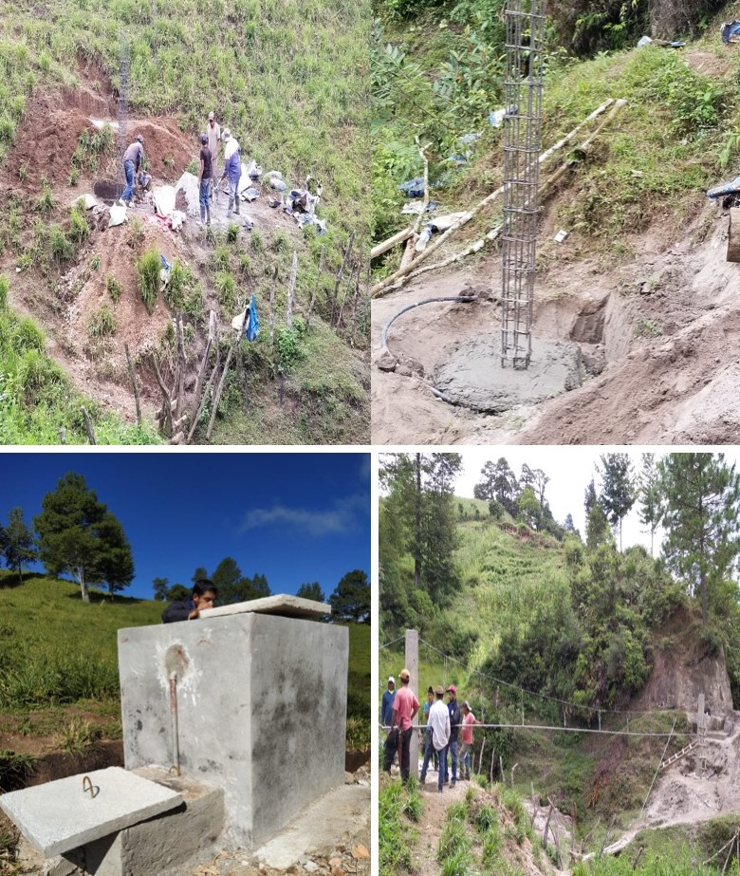
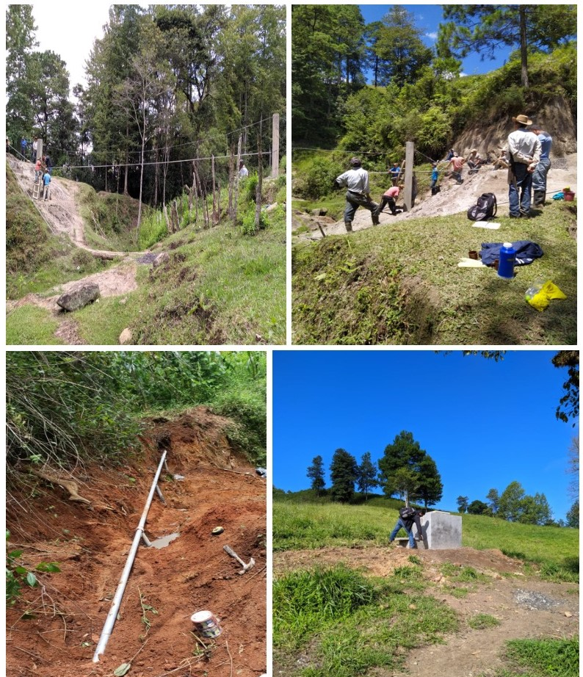
ROTARY CLUB OF SOUTH JACKSONVILLE

Slide 6
RISE AGAINST HUNGER Jodi Henson, Club President 2019-2020 Dan Westra, Club Member Project Partners: Rise Against Hunger City of Fernandina Beach Rotary Club of Fernandina Beach Interact Club of Fernandina Beach HS Local Church Organizations Organized 300 volunteers to pack 59,000 meals for distribution to people in need around the world.

Slide 7
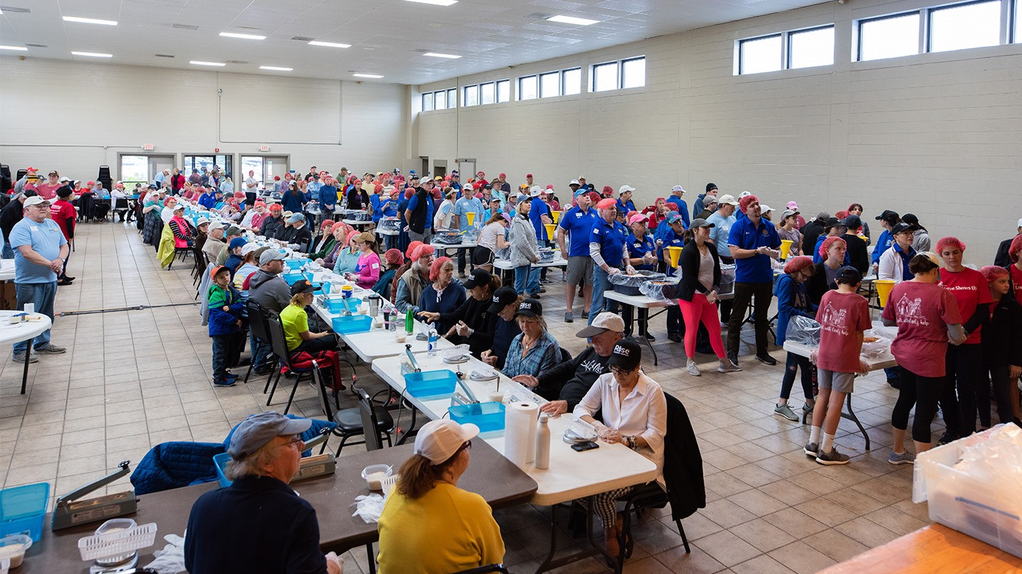
ROTARY CLUB OF AMELIA ISLAND SUNRISE

Slide 8
BARNABAS MEAL PACK & SENIOR Rx FOOD PROGRAM Jodi Henson, Club President 2019-2020 Dan Westra, Club Member Project Partners: Barnabas Center Amelia Island Nassau County School District Delivered fresh food and sundries once a week to 50 local families and senior citizens in need.

Slide 9
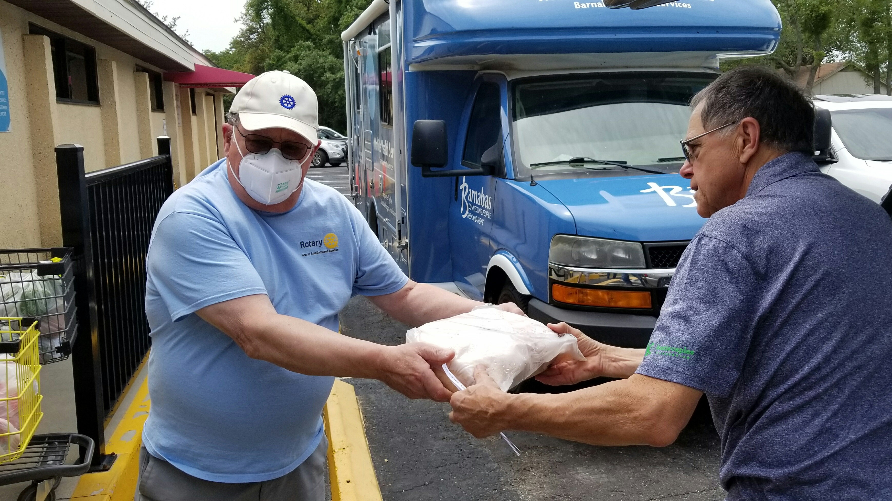
ROTARY CLUB OF AMELIA ISLAND SUNRISE

Slide 10
DOWNTOWN FIT LOOP Brandon Perry, Club President 2019-2020 Frank Ganz, President-Elect 2019-2020 Project Partners: City of Ormond Beach Enhancing public parks with fitness equipment and shade structures for public use facilitating enhanced public health.

Slide 11
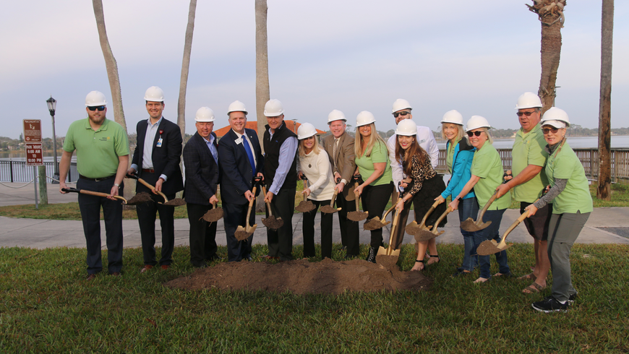
ROTARY CLUB OF DOWNTOWN ORMOND BEACH

Slide 12
FOSTERING EARLY ACT PROGRAMS IN SCHOOLS Jodi Henson, Club President 2019-2020 Dan Westra, Club Member Project Parnters: Emma Love Hardee Elementary School Fernandina Beach Middle School Rotary Club of Fernandina Beach Initiated EarlyAct program in local elementary school that has taught leadership and service principles to nearly 75 young boys and girls. Program has led to formation of an Interact Club at the local middle school.

Slide 13
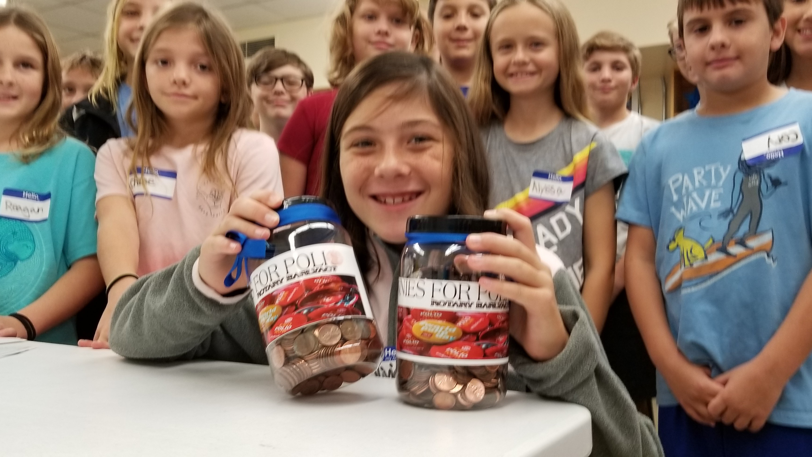
ROTARY CLUB OF AMELIA ISLAND SUNRISE

Slide 14
ROTARY ORATORY COMPETITION Bea Fore, Club President 2019-2020 Greg Anderson, Club Member Project Partners: Rotary Club of Jacksonville Rotary Club of West Jacksonville Rotary Club of Orange Park Rotary Club of Amelia Island Sunrise Rotary Club of St. Augustine WJCT TV Provided research, composition and presentation opportunities to high school seniors in five county area of Florida’s First Coast. Exemplary student orators were awarded college scholarship assistance.

Slide 15
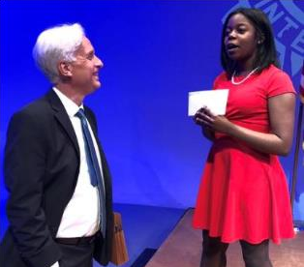
ROTARY CLUB OF SOUTH JACKSONVILLE

Slide 16
BEACHES HEALTH JAM Clarence Hill, Club President 2019-2020 Cathy Hagan, President-Elect 2020-2021 Chris Hoffman, Vice President 2020-2021 Project Partners: Mayo Clinic YMCA BEAM Mobile Food Carver Center Mission House Beaches Rotaract Interact Club of Fletcher High School A fun event with a health theme for underserved communities at the Jacksonville beaches.

Slide 17
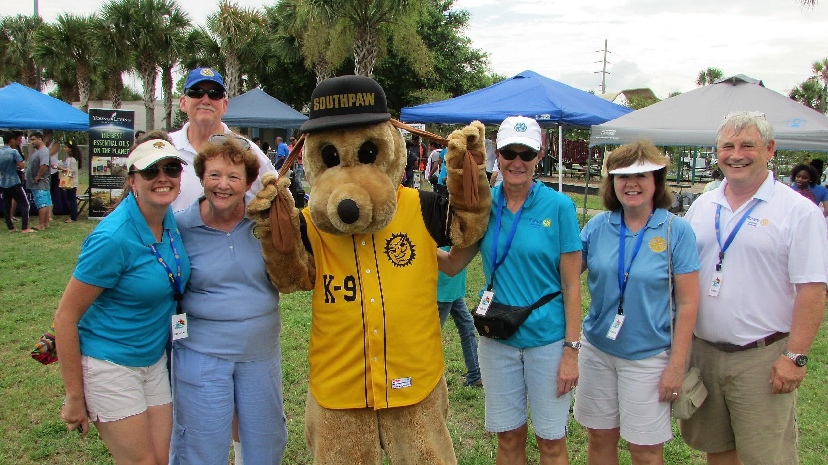
ROTARY CLUB OF JACKSONVILLE - OCEANSIDE

Slide 18
ROTARY SWIM & SURF : MAKING A SPLASH IN FLAGLER COUNTY Roy Sieger, Club President 2019-2020 Roseanne Stocker, President-Elect 2019-2020 Project Partners: City of Flagler Beach Ocean Rescue Urban Surf4Kids Provided swim, surf and water safety lessons as well as conflict resolution skills for children. Encouraged and provided means for minority, at-risk and economically disadvantaged youth to participate.

Slide 19
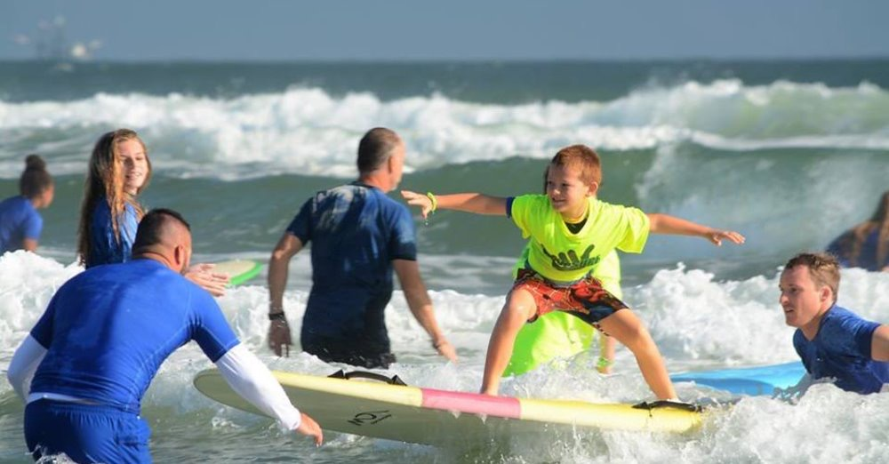
ROTARY CLUB OF FLAGLER BEACH

